Slide 1
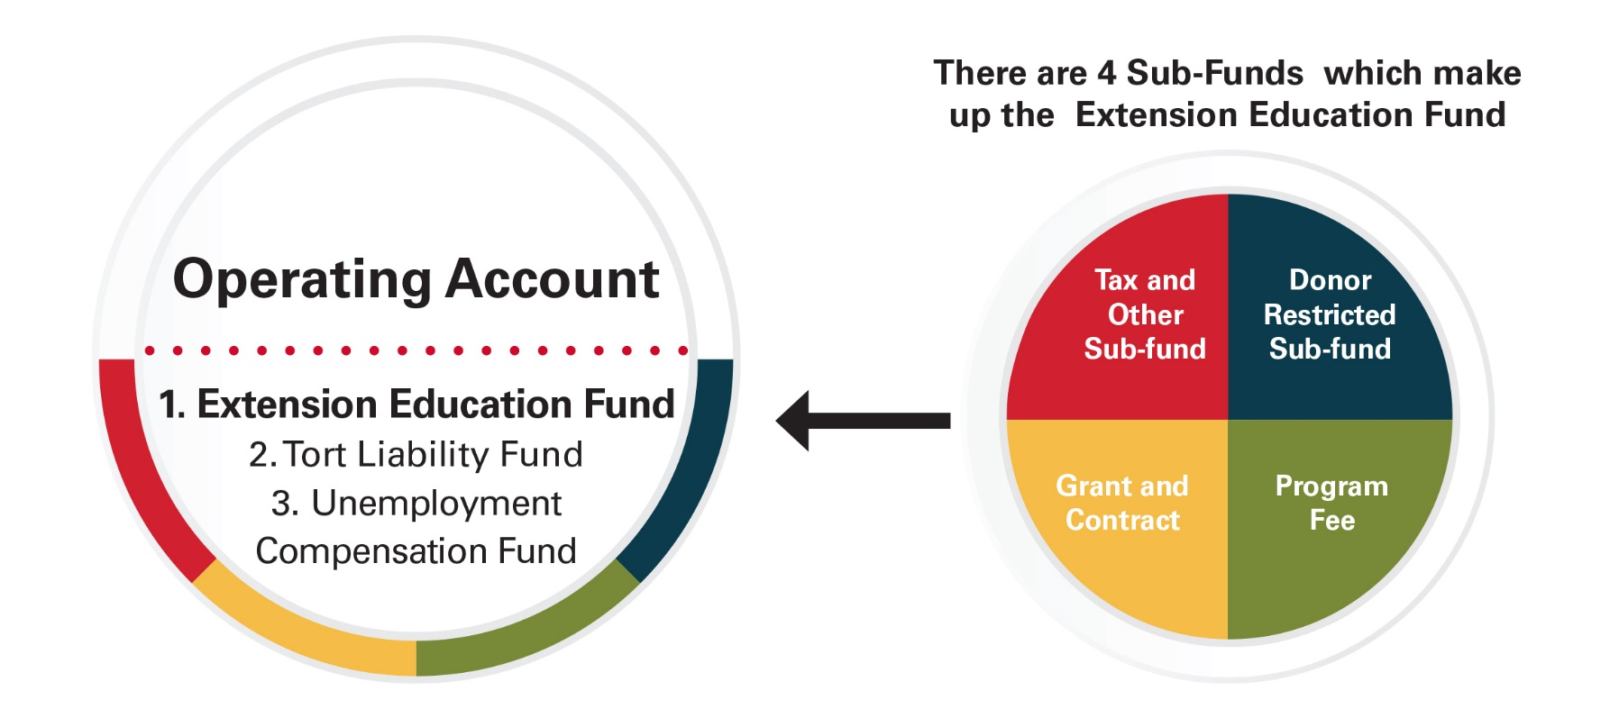
Fund Accounting 101
Agency Account is completely separate from the Operating Account, with its own checking account.
Notes:
Handout provided…….explains the 4 categories/sources of funds within the saving and checking accounts of a district. Grants/contracts are restrict use do to the goals and guidelines of the grant. Fee program is client assessed and used to support program expenses and future development. Use handout 8

Slide 2
Iowa Code 176A.8(13)
13. To carry over unexpended county agricultural extension education funds into the next year so that funds will be available to carry on the program until such time as moneys received from taxes are collected by the county treasurer. However, the unencumbered funds in the county agricultural extension education fund in excess of one-half the amount expended from the fund in the previous year shall be paid over to the county treasurer. The treasurer of the extension council with the approval of the council may invest agricultural extension education funds retained by the council and not needed or current expenses in the manner authorized for treasurers of political subdivisions under section 12C.1.

Slide 3
Carryover Opinion – Attorney General (2009)
“I am writing in follow up to Keith's e-mail of June 10, 2009 regarding the County Ag Extension Carryover provision of Iowa Code § 176A.8(13). I agree with the conclusion reached that program and/or participant fees collected by ISU Extension that are used to offset the cost of a particular program and related services are exempt from the carryover provision of § 176A.8(13).”
Full Opinion – County Services Website
https://www.extension.iastate.edu/countyservices/program-fee-carryover-opinion-attorney-general-2009

Slide 4
Carryover Rule
The extension district may carryover in the tax sub-fund up to 50% of the that year’s tax sub-fund expenditures
Notes:
Use example R&E reports to help them determine how limits are determined HANDOUT 14

Slide 5
What circumstances would cause a carryover issue?
Vacancy in staffing positions
Expenses considerably less than budgeted
Notes:
GROUPS of 3-5 people, HANDOUT 14

Slide 7
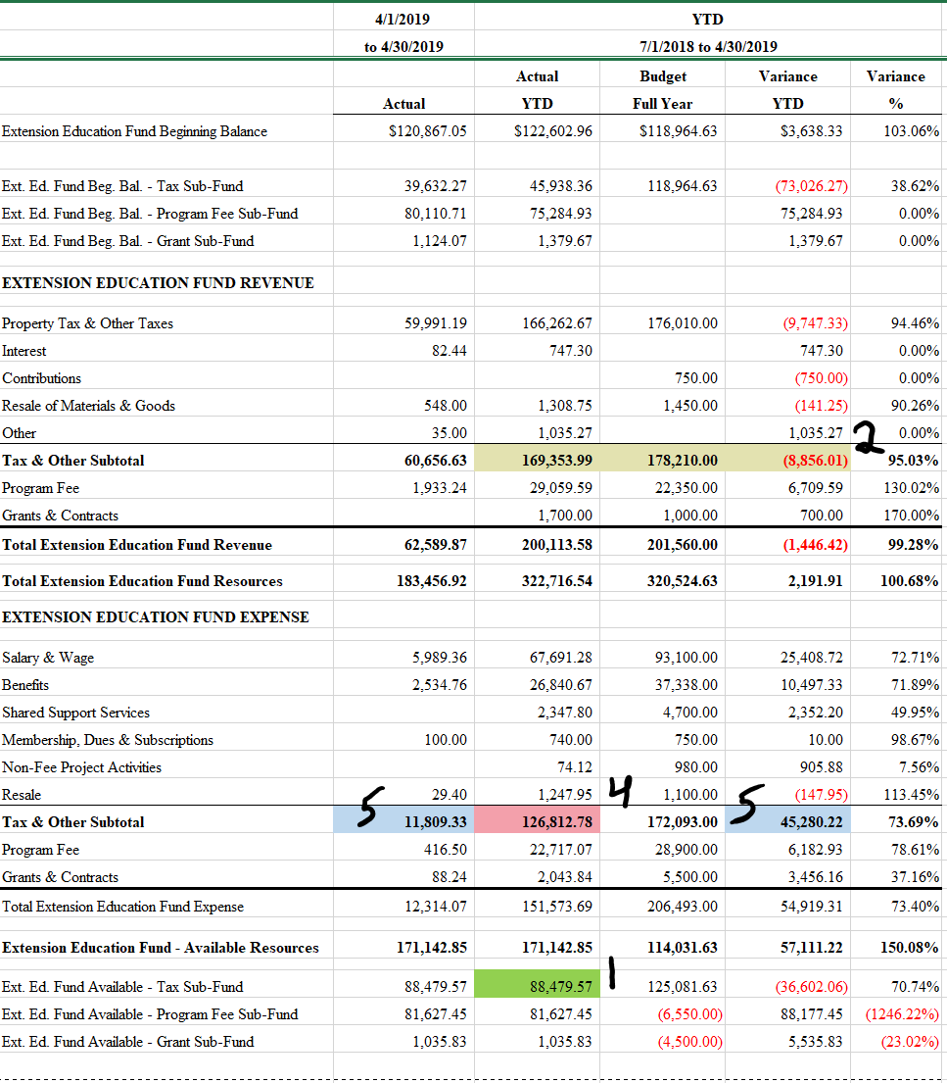

Slide 8
Example 1

Slide 10
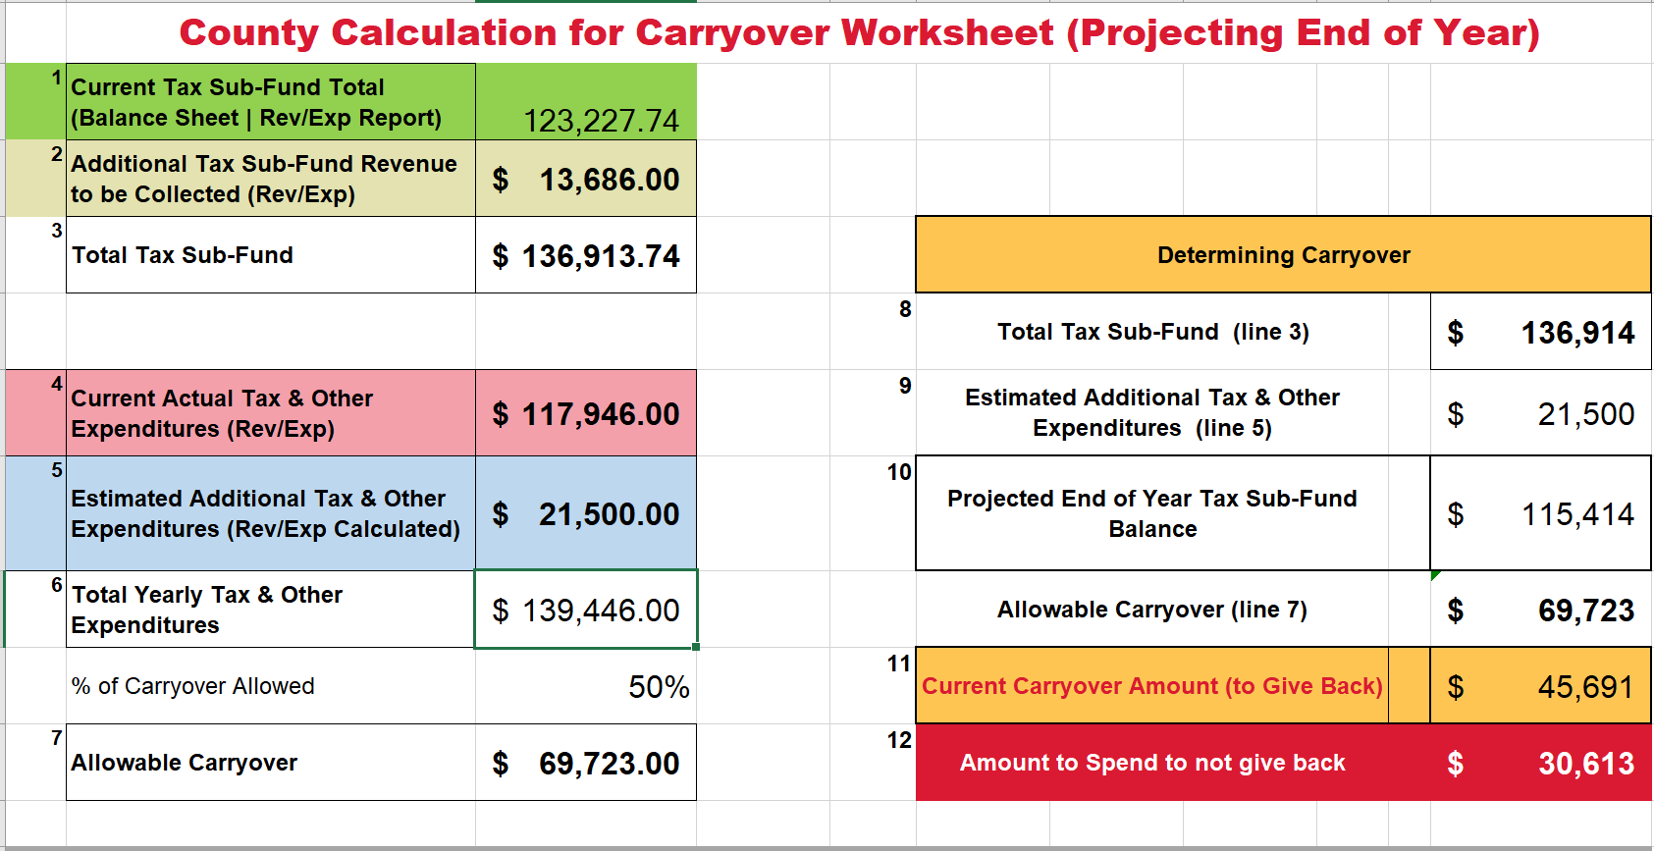
Example 2

Slide 11
Strategies to reduce your carryover
Work with your Regional Director and County Director
Strategies vary by county and situation
*Not all solutions require new spending
Examples used to clean-up carryover:
Purchase updated equipment/computers
Professional development
Purchase curriculum, supplies
Subsidize programming for the public
Contract for future service
Marketing
Programs

